Slide 1
Sprint 01. Classes, Access modifiers. Class System.Object

Slide 2

Agenda
Classes. Access modifiers
Static, readonly, const
Operators overriding. Indexators, type cast operators overriding
Class System.Object
Object LifeTime. GC. Destructor and Dispose pattern

Slide 3
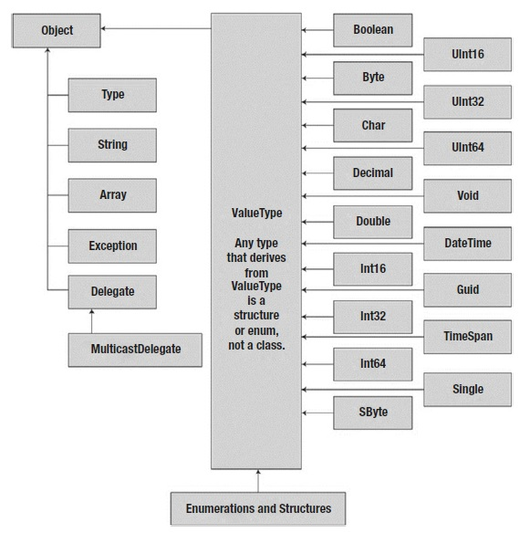
Class
Everything in C# is associated with classes and objects, along with its attributes and methods.
For example: in real life, a car is an object. The car has attributes, such as weight and color, and methods, such as drive and brake.
A Class is like a "blueprint" for creating objects.

Slide 4
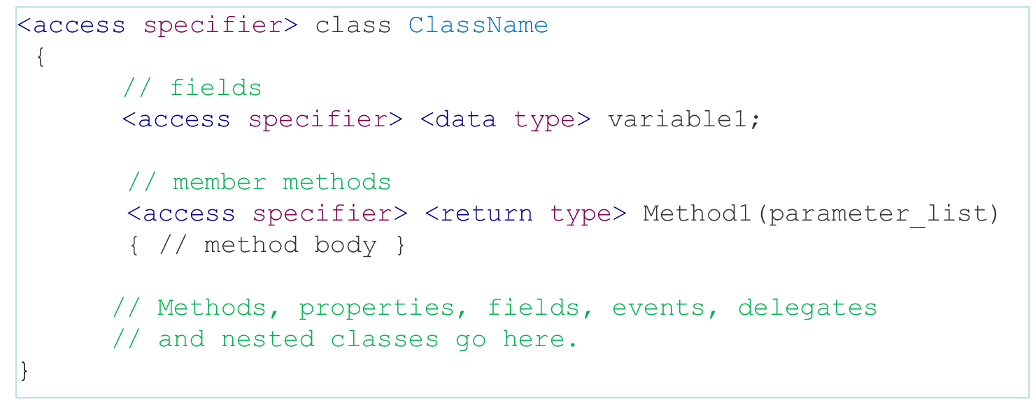
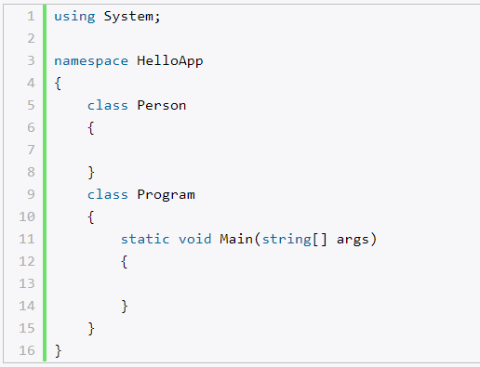
Class declaration

Slide 5

Class Access Modifiers
Access modifiers in C# are used to specify the scope of accessibility of a member of a class or type of the class itself.
Class can be declared as public or internal
public class is accessible to everyone without any restrictions,
internal class may be accessible to the assembly only.

Slide 6
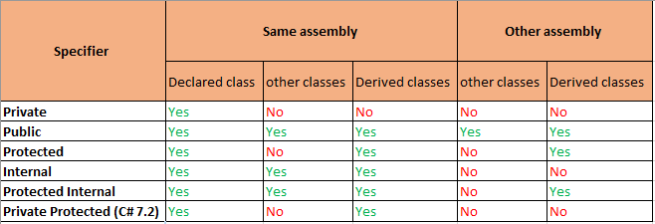
Class Member Access Modifiers

Slide 7
Class declaration. Fields
A field is a variable of any type that is declared directly in a class or struct.
Use fields only for variables that have private or protected accessibility
A field can be initialized in declaration.
public class Doctor
{
private string name;
private double salary =100;
private int expYear;
...
}
name “”
salary 100
expYear 0
doc1
Instances
of class
doc2
name “”
salary 100
expYear 0
Doctor doc1 = new Doctor();
Doctor doc2 = new Doctor();

Slide 8
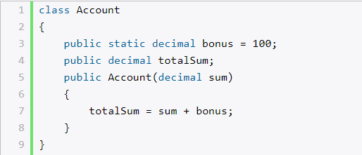
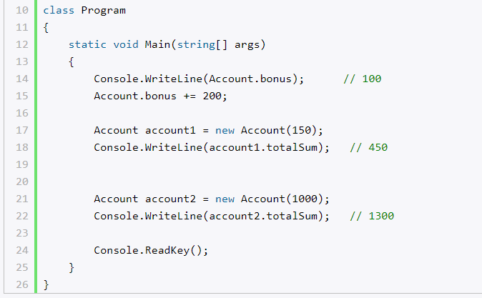
Static, readonly, const
static field and const belong to the class itself, and are shared among all instances of that class.
only C# built-in types (and string or enum)may be declared as const.
Const fields must be initialized as they are declared and do not change for the life of the program
readonly field is const for instance of the class, can be initialized in declaration or in constructor only

Slide 9
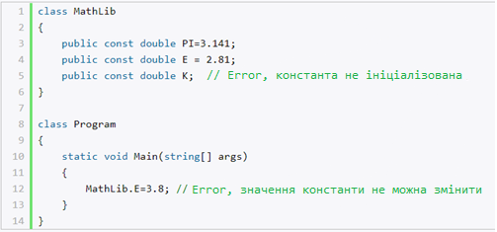
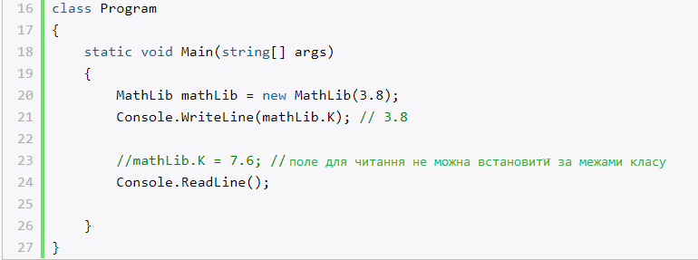
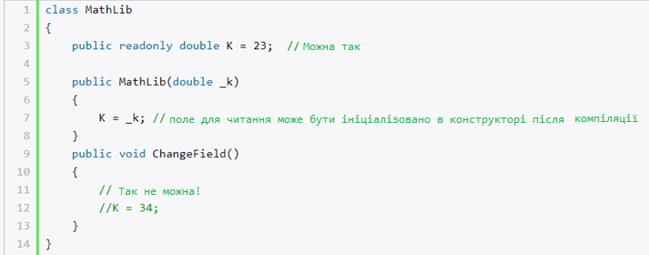
Static, readonly, const examples

Slide 10
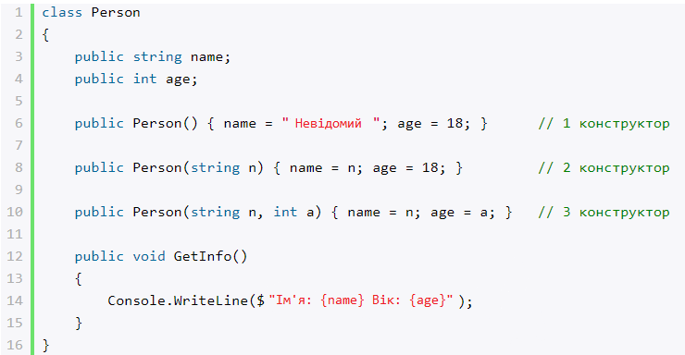
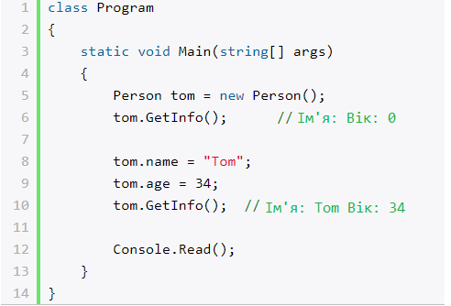
Constructors
A constructor in C# is a member of a class.
It is a method in the class which gets executed when a class object is created.
Usually we put the initialization code in the constructor.
The name of the constructor is always is the same name as the class.
A class can have multiple overloaded constructors.

Slide 11
Keyword “this”
The keyword this represents a link to the current instance of the class.
You can always make the call to one constructor from within the other
public class Book
{
private string author;
private string title;
public Book(string author, string title,)
{
this.author = author;
this.title = title;
}
public decimal Price { get => price; }
}
public class mySampleClass
{
public mySampleClass() : this(10)
{ //This is the no parameter constructor method.
// First Constructor
}
public mySampleClass(int Age)
{
// This is the constructor with one parameter.
// Second Constructor
}
}

Slide 12
Keyword “base”
public class myBaseClass
{
public myBaseClass()
{
// Code for First Base class Constructor
}
public myBaseClass(int Age)
{
// Code for Second Base class Constructor
}
// Other class members goes here
}
public class myDerivedClass : myBaseClass
// Note that I am inheriting the class here.
{
public myDerivedClass()
{
// Code for the First myDerivedClass Constructor.
}
public myDerivedClass(int Age) : base(Age)
{
// Code for the Second myDerivedClass Constructor.
}
// Other class members goes here
}
“base” refers to the base class of the current class

Slide 13
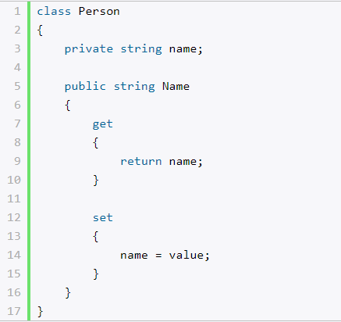
Properties
In addition to the usual methods in the C # language, there are special access methods called properties. They provide easy access to the fields of the class, find out their meaning or install them.
Property is a member that provides a flexible mechanism to read, write, or compute the value of a private field.
Properties can be used as if they are public data members, but they are actually special methods called accessors.

Slide 14
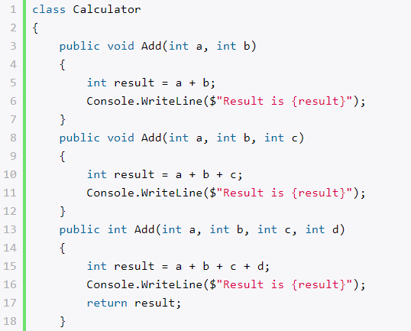
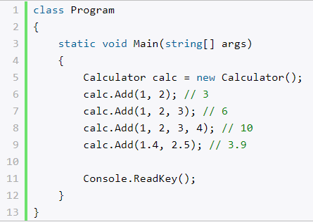

Methods
Methods are declared in a class or struct by specifying the access level, the return value, the name of the method, and any method parameters.

Slide 15
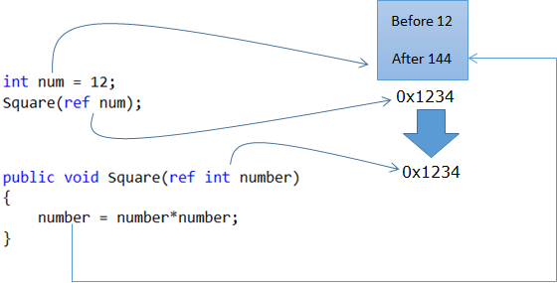
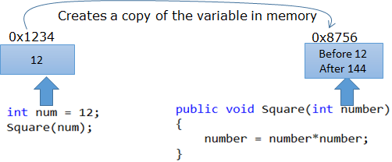
ref parameter modifier
Without ref:
With ref:

Slide 16

out modifier
Out modifier gives the parameters ability to be passed back.
void M(string s1, out string s2)
{
s1 = "one";
s2 = "two";
}
void Main()
{
string s = "hello", t = "world";
// s = "hello"
// t = "world"
M(s, out t);
// s = "hello"
// t = "two"
}

Slide 17
ref vs out
Ref | Out
The parameter or argument must be initialized first before it is passed to ref. | It is not compulsory to initialize a parameter or argument before it is passed to an out.
It is not required to assign or initialize the value of a parameter (which is passed by ref) before returning to the calling method. | A called method is required to assign or initialize a value of a parameter (which is passed to an out) before returning to the calling method.
Passing a parameter value by Ref is useful when the called method is also needed to modify the pass parameter. | Declaring a parameter to an out method is useful when multiple values need to be returned from a function or method.
It is not compulsory to initialize a parameter value before using it in a calling method. | A parameter value must be initialized within the calling method before its use.
When we use REF, data can be passed bi-directionally. | When we use OUT data is passed only in a unidirectional way (from the called method to the caller method).
Both ref and out are treated differently at run time and they are treated the same at compile time.
Properties are not variables, therefore it cannot be passed as an out or ref parameter.

Slide 18
Operator overloading
You can redefine or overload most of the built-in operators available in C#.
Overloaded operators are functions with special names: the keyword operator followed by the symbol for the operator being defined.
similar to any other function, an overloaded operator has a return type and a parameter list.
Only some operators can be overloaded:
unary: + , - , !, ~, ++, --, true, false
binary: +, -, *, /, %, &, |, ^, <<, >>, ==, !=, >, <, >=, <=
Some operators should be overloaded in pair:
== and !=
> and <
>= and <=
true and false

Slide 19
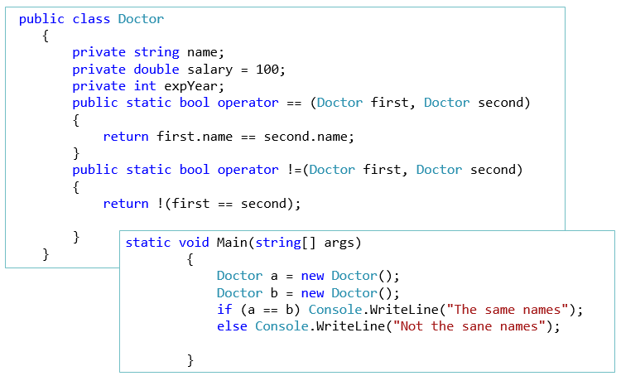
Operator overloading. Example

Slide 20
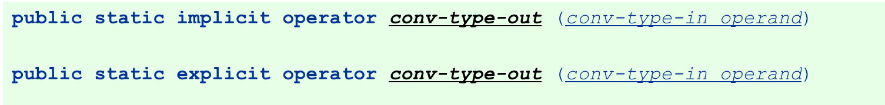
Type conversion operators
Classes or structs can be converted to and/or from other classes or structs, or basic types
Conversions are defined like operators and are named for the type to which they convert.
Conversions declared as implicit occur automatically when it is required.
Conversions declared as explicit require a cast to be called.
All conversions must be declared as static.

Slide 21
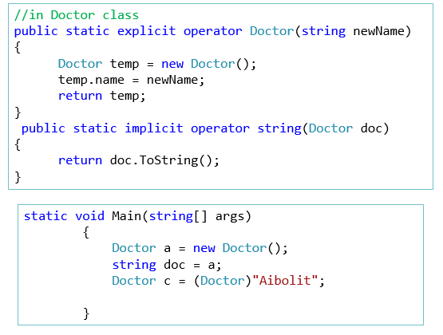
Type conversion operators. Example

Slide 22
System.Object class
Object is the base type for all data types in c#.
Methods of Object:
ToString - method is used to get a string representation of this object. For base types, their string value will simply be displayed:
GetHashCode - method allows to return some numeric value that will correspond to a given object or its hash code. By this number, for example, you can compare objects. You can define a variety of algorithms for generating a similar number or take the implementation of the basic type:
GetType - method allows to get the type of object:
Equals - method allows to compare two objects for equality:

Slide 23
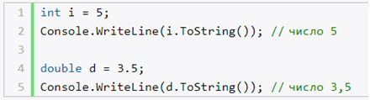

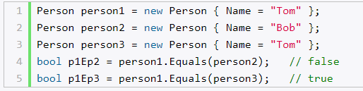
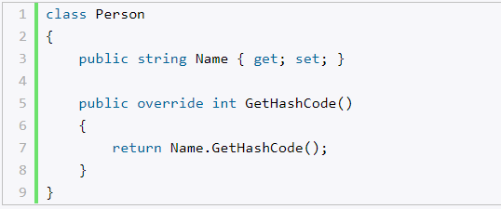
System.Object class

Slide 24

Object lifetime. GC
Object lifetime is the time when a block of memory is allocated to this object during some process of execution and that block of memory is released when the process ends.
Automatic garbage collection manages memory for all .NET applications.
Garbage Collector releases memory automatically for us when the object is no longer used.

Slide 25
Generations
The heap is categorized into three generations so it can handle long-lived and short-lived objects.
Generation 0: Newly created objects are at Generation 0. These objects on Generation 0 are collected frequently to ensure that short-lived objects are quickly collected and the memory is released. Objects that survive Generation 0, the collections are promoted to Generation 1. Most objects are reclaimed for garbage collection in Generation 0 and do not survive to the next generation.
Generation 1: Objects that are collected less frequently than Generation 0 and contains longer-lived objects that were promoted from Generation 0. Objects that survive Generation 1, collection are promoted to Generation 2.
Generation 2: Objects promoted from Generation 1 that are the longest-lived objects and collected infrequently. The overall strategy of the garbage collector is to collect and move longer-lived objects less frequently.
Notes:
Read more here: https://docs.microsoft.com/en-us/dotnet/standard/garbage-collection/fundamentals

Slide 26
Work with Garbage Collector
GC class Controls the system garbage collector
Some useful methods of GC class:
Collect() | Forces an immediate garbage collection of all generations.
SuppressFinalize(Object) | Requests that the common language runtime not call the finalizer for the specified object.
GetGeneration(Object) | Returns the current generation number of the specified object.
GetAllocatedBytesForCurrentThread() | Gets the total number of bytes allocated to the current thread since the beginning of its lifetime.

Slide 27

Work with unmanaged resources
When you create objects that include unmanaged resources, you must explicitly release those resources when you finish using them in your app.
The most common types of unmanaged resource are objects that wrap operating system resources, such as:
files
windows
network connections
database connections

Slide 28
Disposing with Finalizer
public class SomeResource
{
public string Name { get; set; }
~SomeResource()
{
//releasing unmanaged resources here
}
}
protected override void Finalize()
{
try
{
//releasing unmanaged resources here
}
finally
{
base.Finalize();
}
}
Compiler will generate
Finalizer
Developers don’t have direct access to Finalize method, they should use finalizers.

Slide 29
Disposing with IDisposable
public class Person : IDisposable
{
public string Name { get; set; }
public void Dispose()
{
//disposing unmanaged resources here
}
}
private static void Test()
{
Person p = null;
try
{
p = new Person();
}
finally
{
if (p != null)
{
p.Dispose();
}
}
}

Slide 30
Dispose pattern
public class SomeClass : IDisposable
{
private bool disposed = false;
// implementation of IDisposable.
public void Dispose()
{
Dispose(true);
GC.SuppressFinalize(this);
}
protected virtual void Dispose(bool disposing)
{
if (!disposed)
{
if (disposing)
{
// release managed resources here
}
// release unmanaged resources here
disposed = true;
}
}
// Finalizer
~SomeClass()
{
Dispose(false);
}
}
Use finalizers only if necessary due to performance influence.
When some class inherits a base class that implements IDisposable, derived class should call Dispose of the base class
public class Derived : Base
{
private bool IsDisposed = false;
protected override void Dispose(bool disposing)
{
if (IsDisposed) return;
if (disposing)
{
// disposing managed resources here
}
IsDisposed = true;
base.Dispose(disposing);
}
}

Slide 31
Thank you!

Slide 32


